Slide 1
Slope stability problem of the Hillock portion of Kanupur Irrigation Project, Keonjhar district, Odisha
Geological Survey of India, Eastern Region, State Unit: Odisha, Bhubaneswar
Presented by
Dr. Debaprasad Sahoo
Authors: D. Sahoo, D. Bhattacharya,
S. Kumar, Jaydip Mukherjee

Slide 2
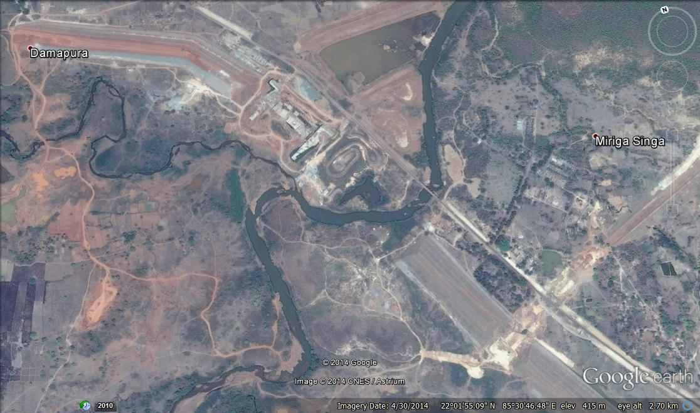
PANAROMIC VIEW OF KANUPUR IRRIGATION PROJECT
D/S
spillway
Sona river
Hillock
Baitarani
Head regulator
Length of the Dam-3400 m
Hight-48 m
Homogenous earth dam on two flank.
Spillway at right flank
Mainly Irrigation Purpose.

Slide 3
GEOLOGY OF THE PROJECT AREA
Location
The Project site is located to the east of Bonai-Keonjhar horse shoe fold belt.
Mainly occupied by Archaean Supracrustals of Iron Ore Supergroup which is unconformably overlying the Singhbhum Granite Complex, later intruded by dolerite dykes. .
At the hillock site, the basement Singhbhum Granite is overlain by Kolhan Group with a basal conglomerate and ferrugeious sandstone/quartzite at the top.

Slide 4
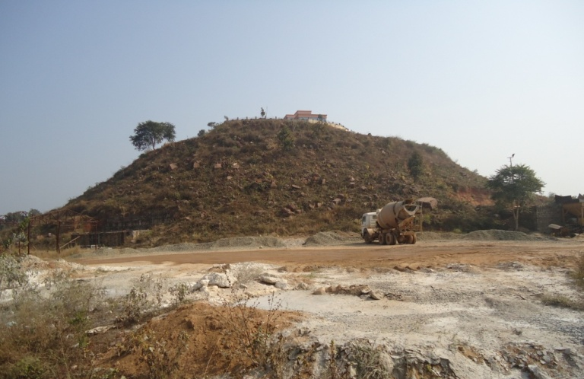
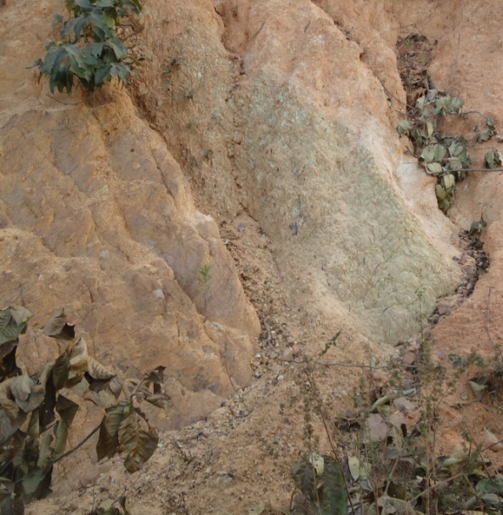
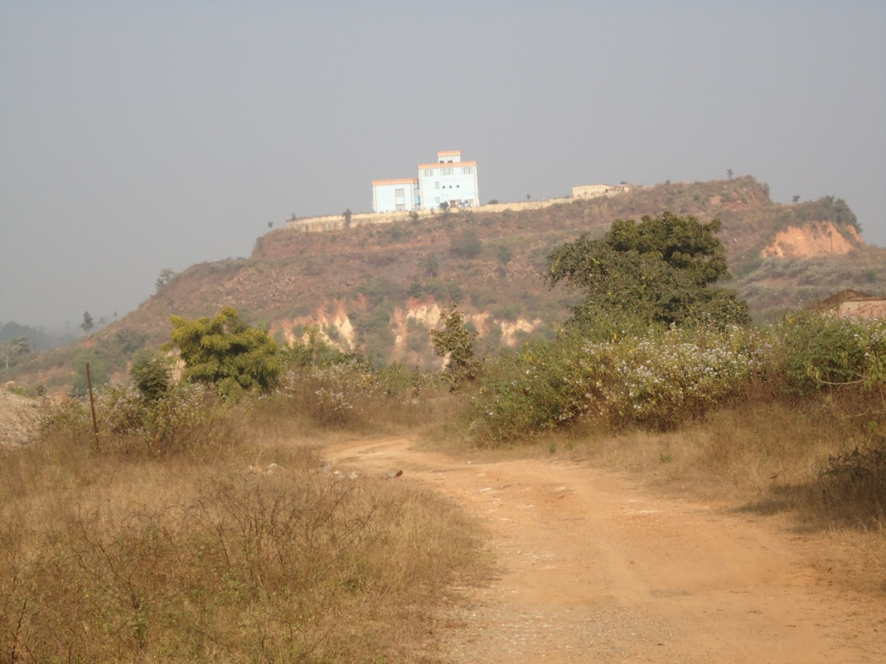
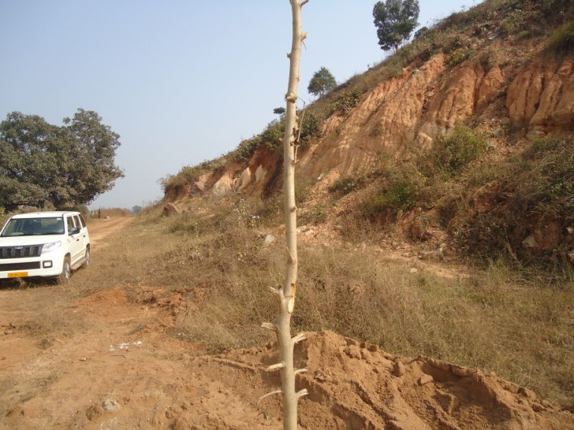
PROBLEM ANTICIPITATED
Anticipitating stability problem of hill slope of the Hillock portion (RD 1440 m –RD 1650 m) after impounding of reservoir.
HILLOCK
Upstream face of the hillock
downstream face of the hillock
Gulley formed in feldspathic granite

Slide 5
HOW TO RESOLVE THE ISSUE?
SURFACE & SUBSURAFCE STUDIES OF THE HILLOCK PORTION
SURFACE STUDIES:
Detailed Geological Mapping
SUBSURFACE STUDIES:
Interpretation of drill core

Slide 6
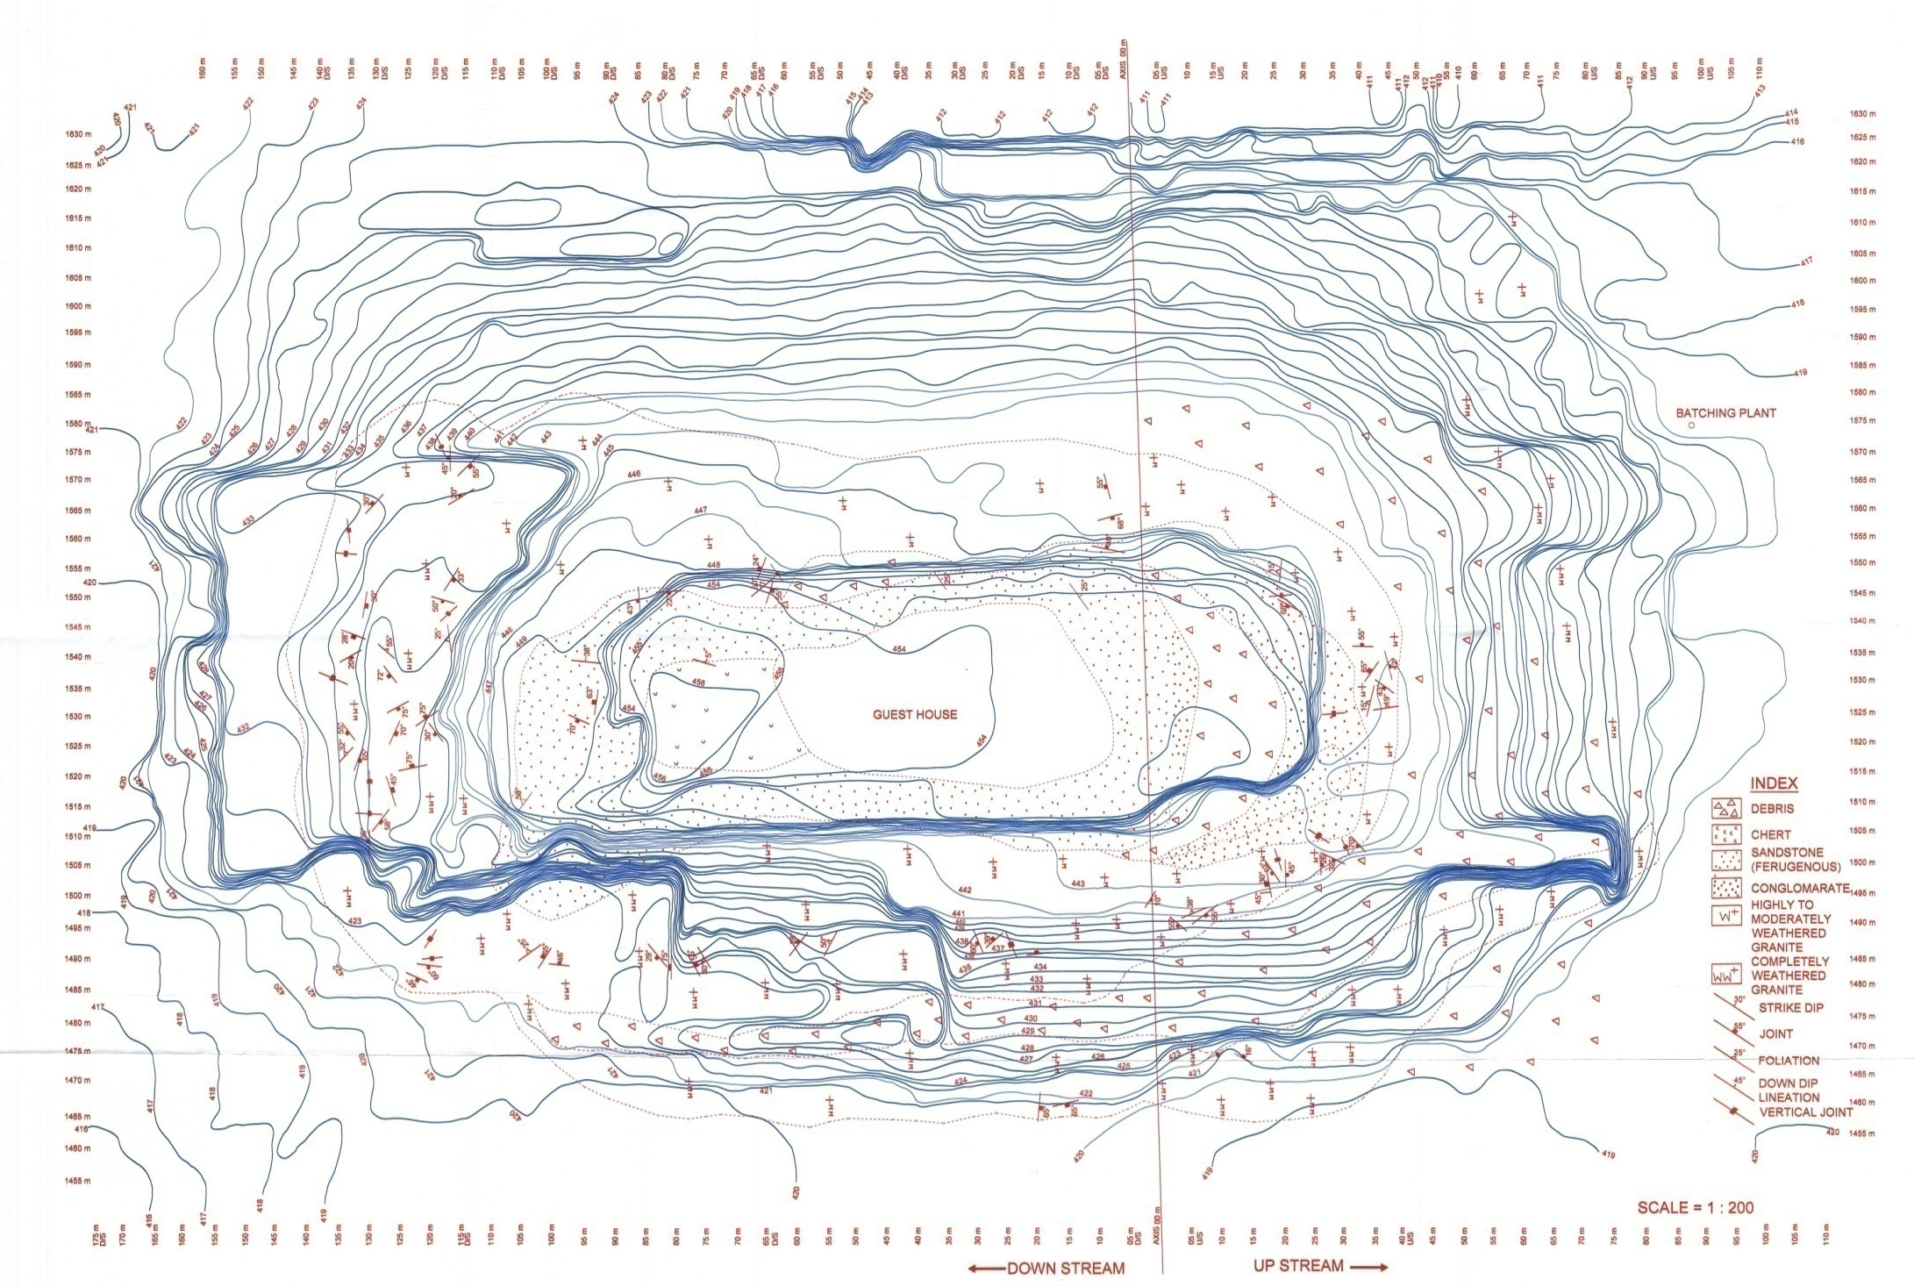
DETAILED GEOLOGICAL MAP OF THE AREA
N

Slide 7
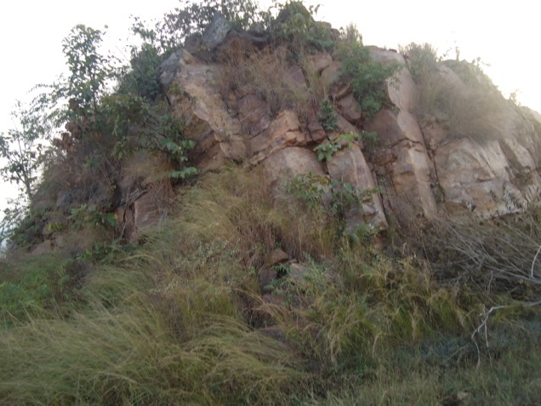
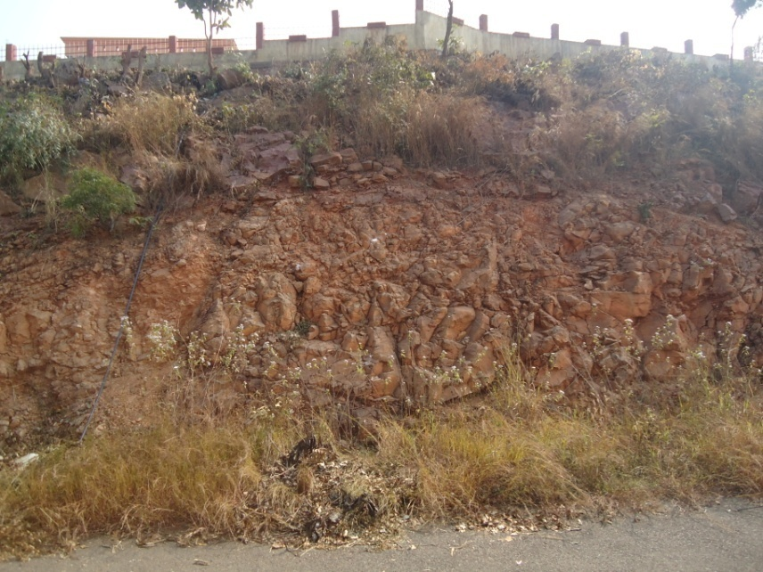
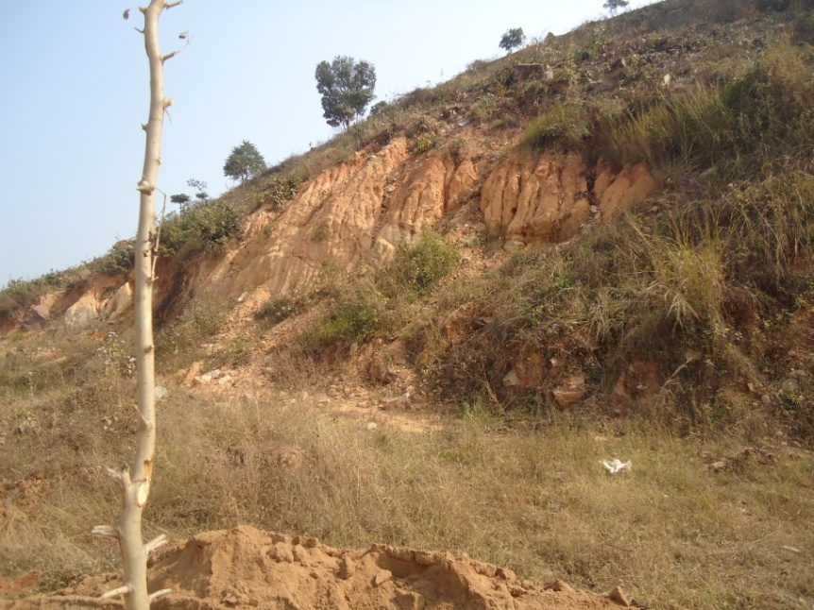
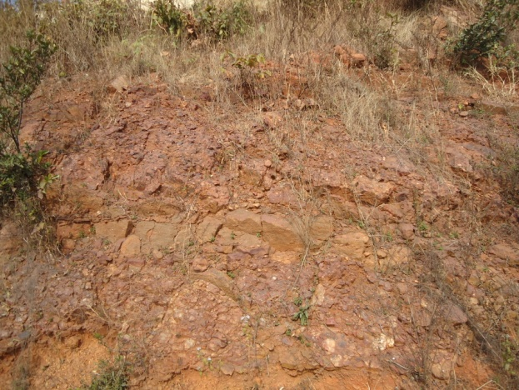
Ferruginous sandstone & cherty quartzite
Polymictic conglomeate –consisting of subrounded to rounded pebbles of BHQ, BHJ, chert & metabasic rock
Highly weathered & decomposed granite (W4-W5 weathering grade) and moderately weathered granite (W3-W4 grade)

Slide 8
SUBSURFACE STUDIES
Drill holes has been drilled in & around the hillock to assess the subsurface condition.
Study of drill core logging indicates:
Weathered bed rock - surface level to 7.5 m depth.
Fresh rock (granite gneiss/metabasic)- 19.85 m-24.8 m

Slide 9
One bore hole was drilled from the top of the hillock
to know the entire succession of the Hillock portion

Slide 10
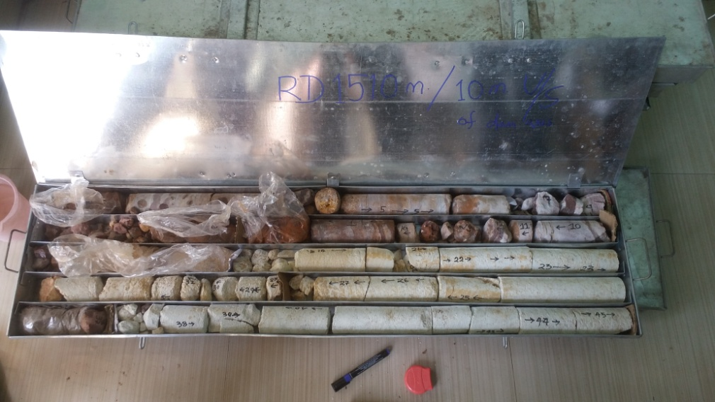
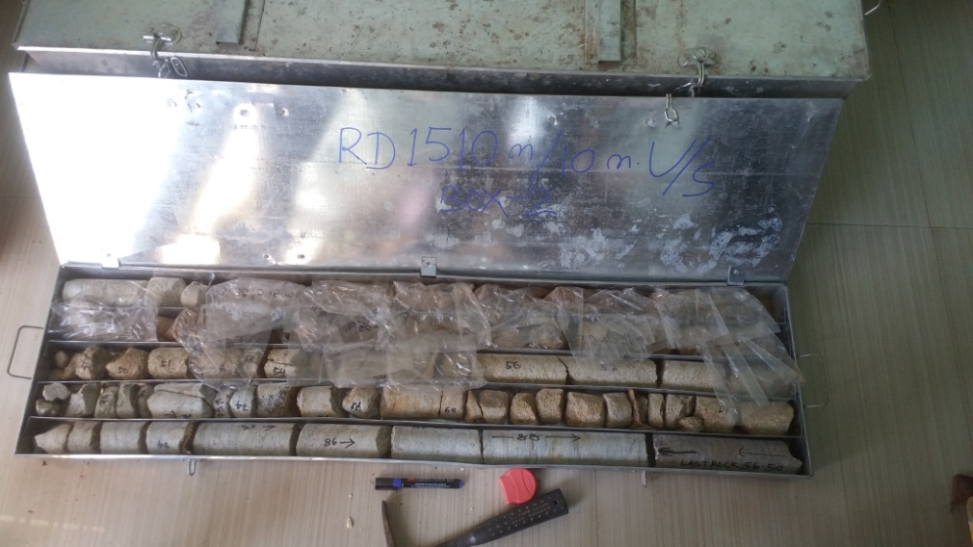
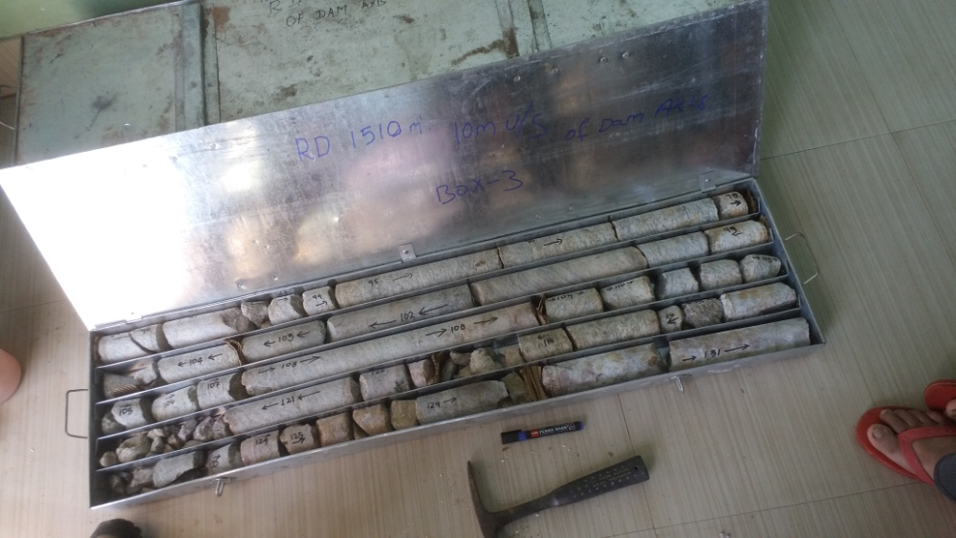
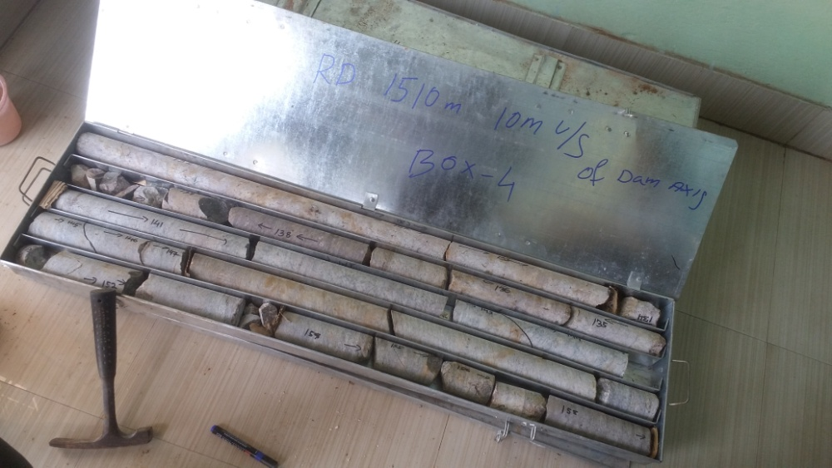
Box-1
Box-2
Box-3
Box-4

Slide 11
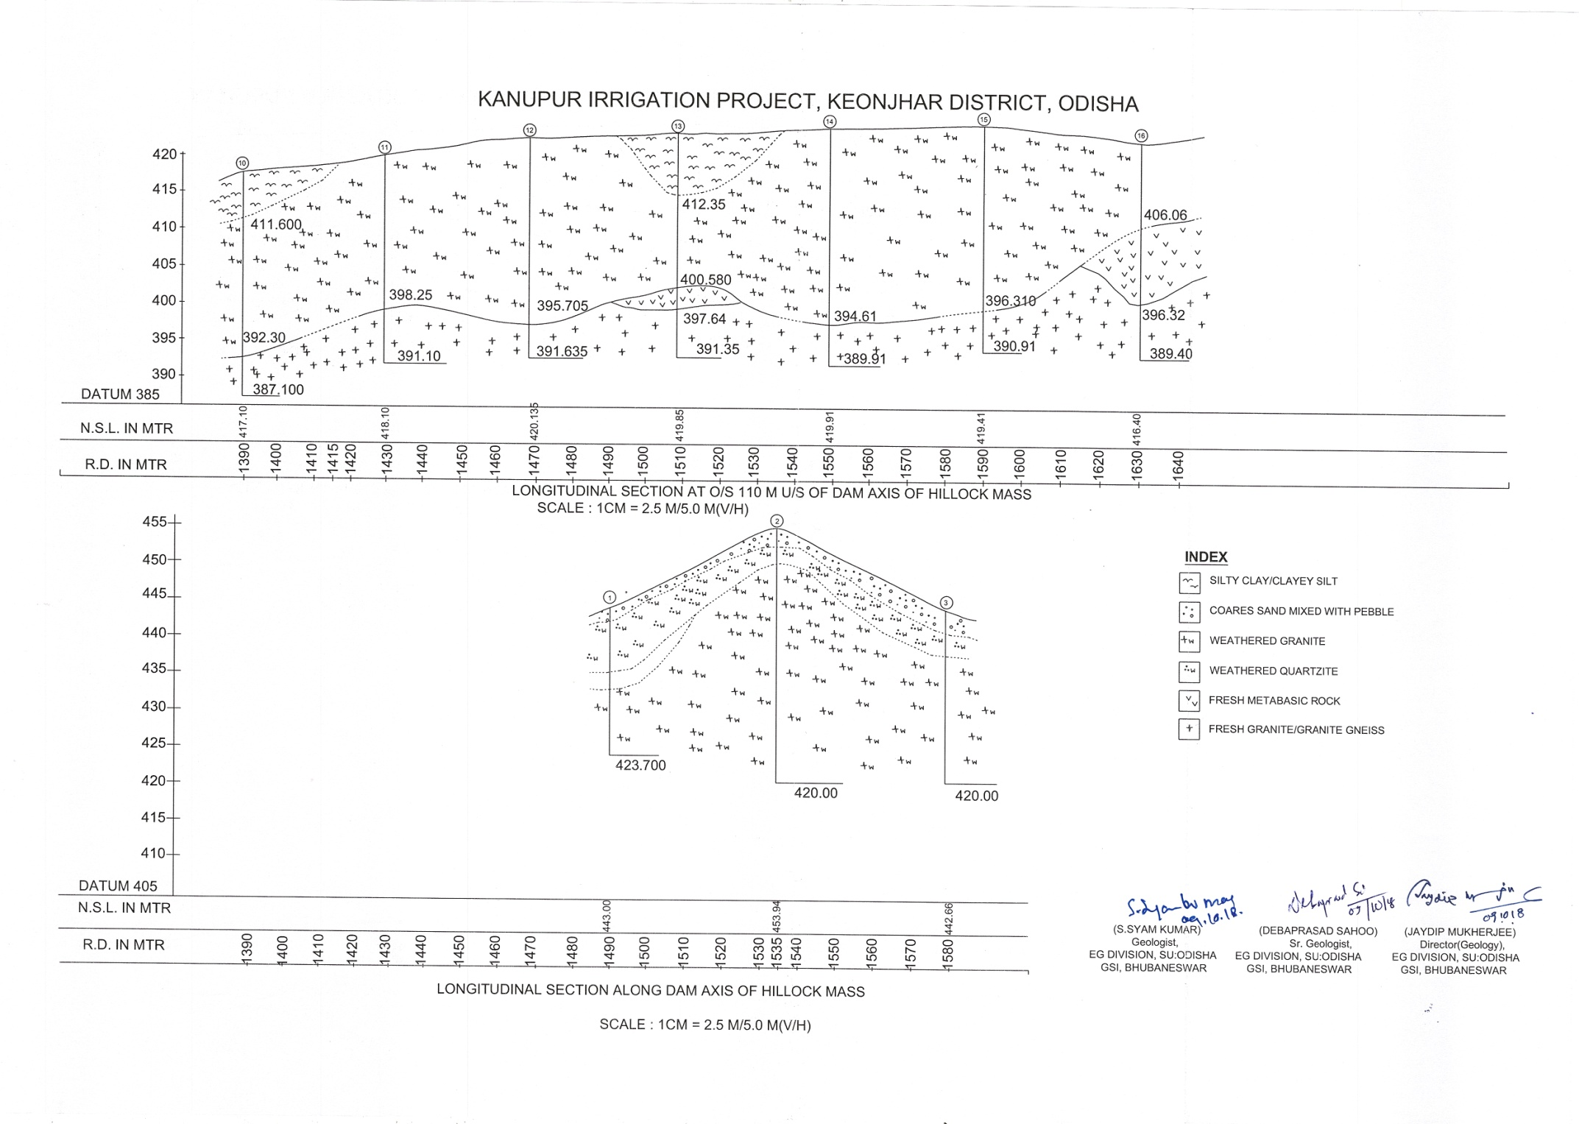
GEOLOGICAL SECTIONS BASED ON DRILL CORE LOG DATA

Slide 12
Groutibility test carried out around the Hillock indicates a positive groutibility of the rock mass.
Water loss upto a depth 30 m : 10.39 Lugeon- 337.42 Lugeon.
Post grout water loss : Nil

Slide 13
For protecting hillock portion from the reservoir, the following remedial measures are to be taken after due consideration.
Provision of curtain grouting in the upstream part of hillock encircling the whole hill mass along with consolation grouting.
Provision of protection wall encircling the hillock portion with foundation on fresh, hard granite/granite gneiss.
Provision of standard section of earth dam with partial cut off and grout curtain with proper benching of hill slope.

Slide 14
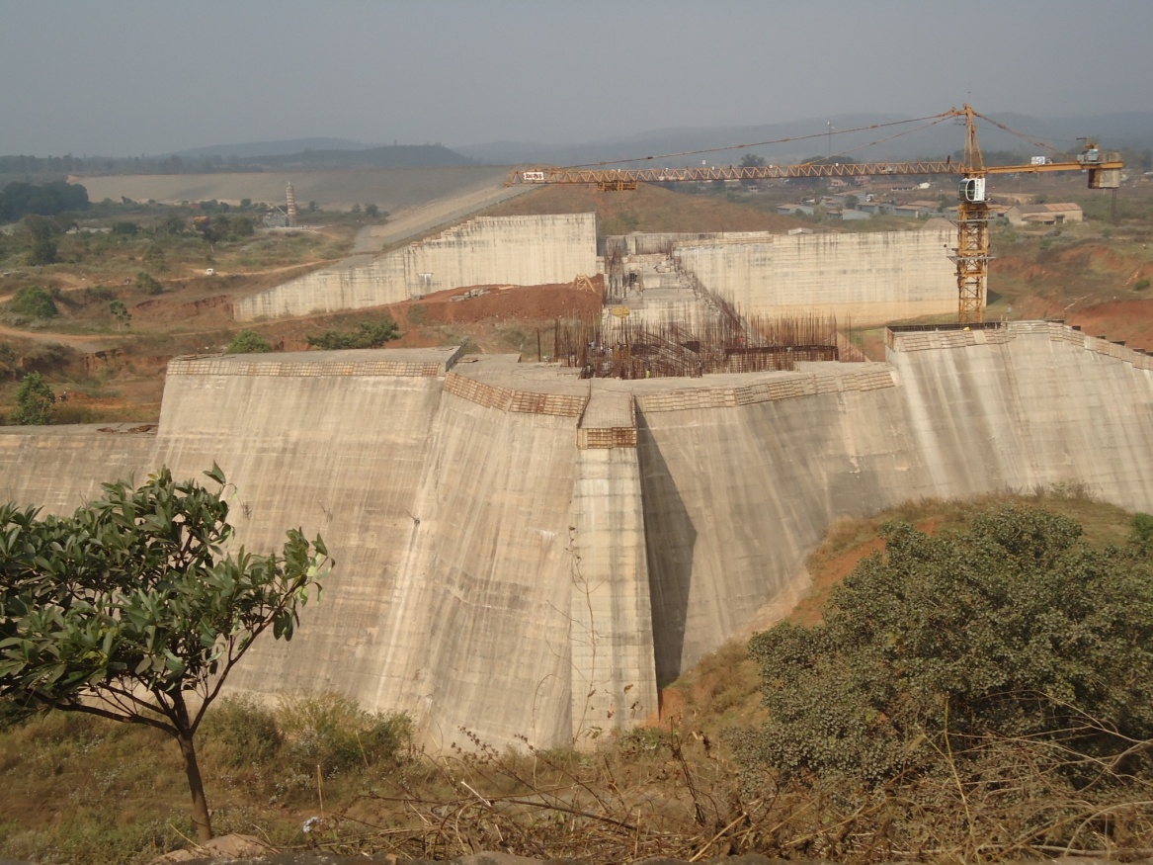
THANK YOU

